Slide 1
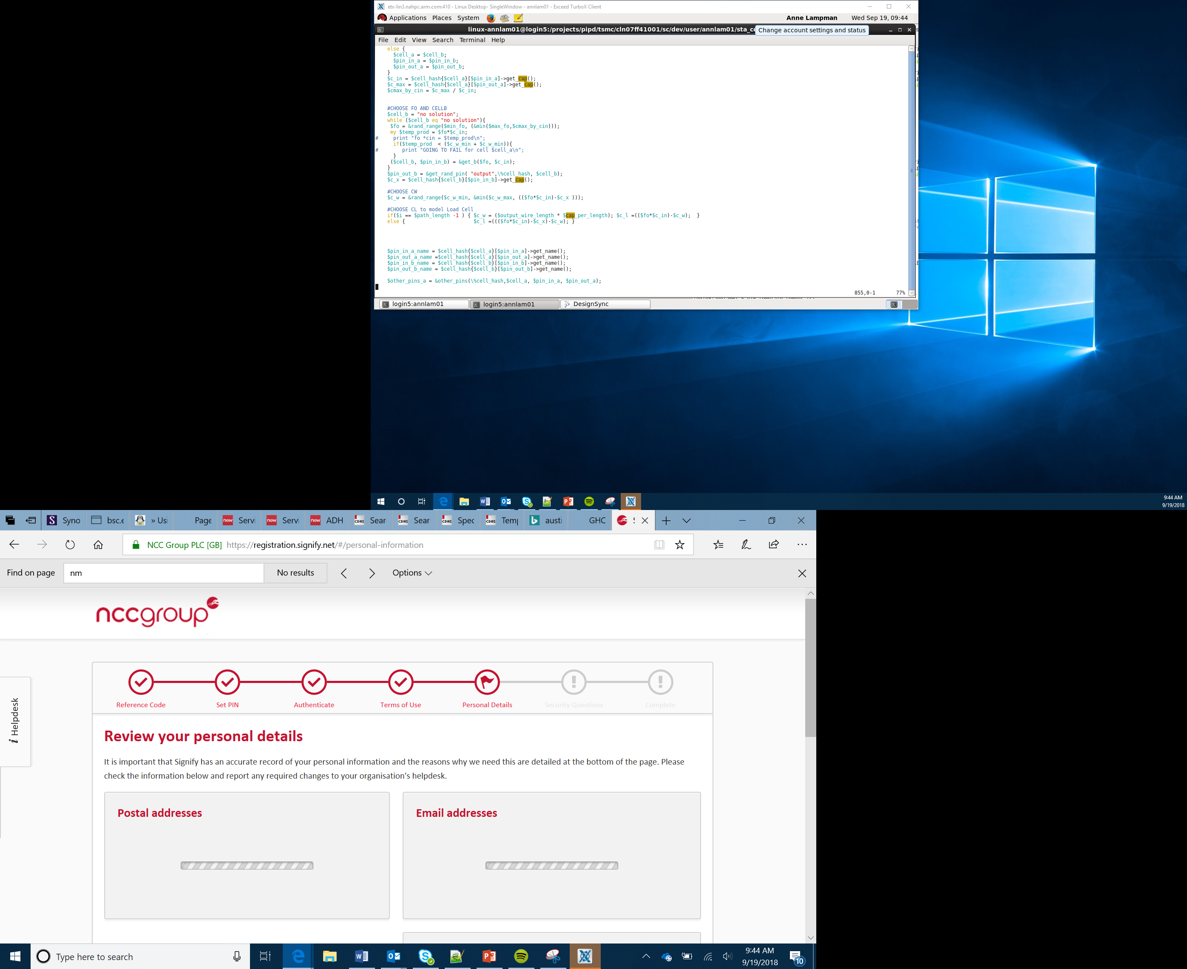

Biodome
Lesson 6
Notes:
Introduce students to the overall purpose of the lesson. Today they will be combining a wide range of sensors to measure a range of environmental considerations. They will also incorporate LEDs as an output device to create light within the Biodome.

Slide 2
Success criteria
Create a circuit using a breadboard
Create a system to monitor and record environmental conditions within a planted biodome
The system will turn input and output devices on and off automatically depending upon readings taken by a sensor

Slide 3
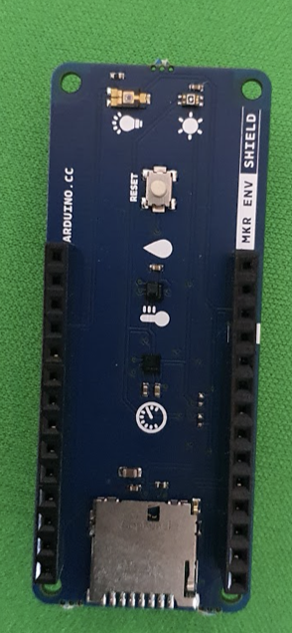
The MKR Env Shield
The MKR ENV Shield contains a wide range of sensors
Research the shield and identify the name of the different sensors
How could these measurements be useful when building a Biodome?
Notes:
Show students the MKR ENV Shield. They will see that there are a wide range of different sensors which could be used to measure the environment. Students should research the device and identify the different sensors. They should complete the Env Worksheet. Ask students to think about how these different measurements may be useful in a Biodome. They should also note these on the worksheet. After 10 to 15 mins discuss the findings. Students may identify the temperature sensor could be used to determine whether the dome needs to be heated. The humidity could determine whether the dome needs to be sprayed with water.

Slide 4
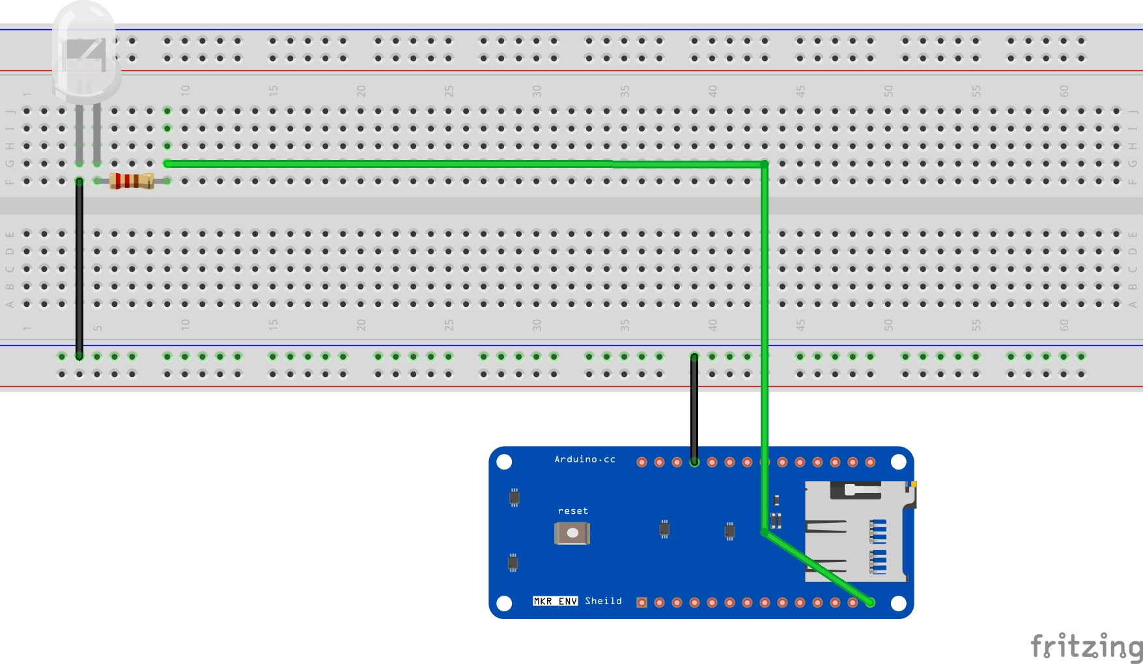
Breadboard
The different sockets on the Arduino need to be expanded in order to be able to attach output devices such as LEDs
The breadboard allows you to build a wide range of electrical circuits which can be controlled by the Arduino
Build the initial LED circuit
Use the worksheet to help you build and code the device
Notes:
Show students the circuit that they will be building. It would be useful to have prepared and tested on complete device prior to the lesson so that they have something to refer to in case of difficulties. The worksheet talks them through the full process. Example code files are contained within the resources.

Slide 5
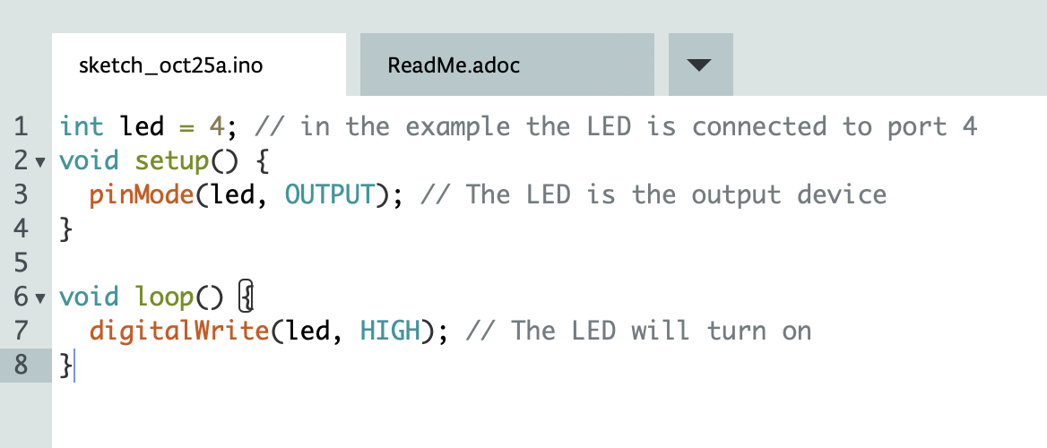
Writing the code to test the LED

Slide 6
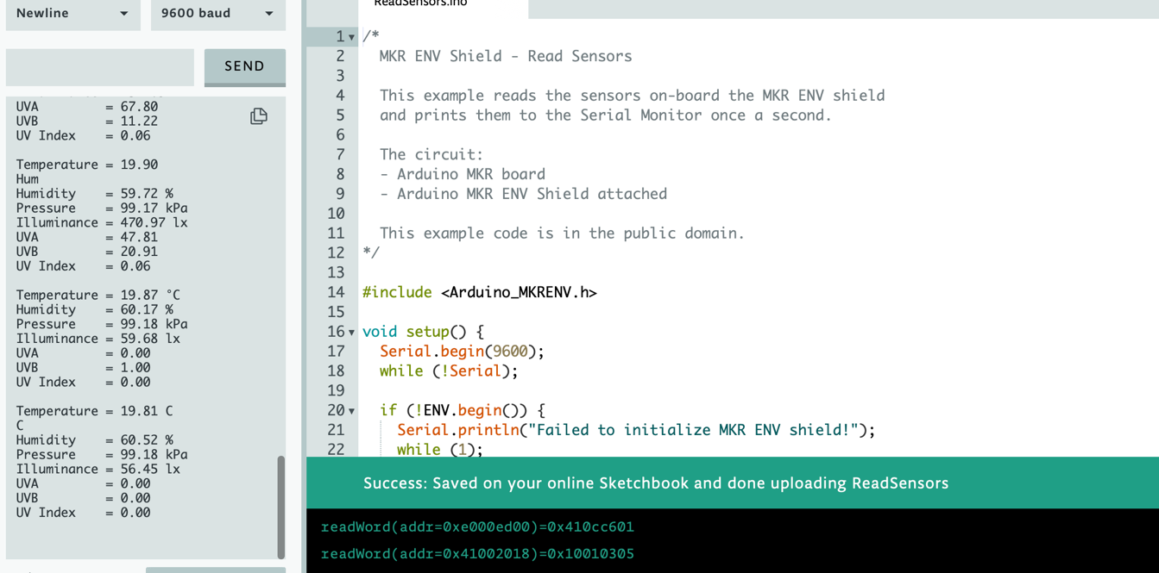
Trying out the MKR Env Shield
You should now add the MKR ENV shield to your Arduino
Try out the sample code to see the different measurements that are taken
Notes:
Students should connect their MKR ENV Shield. They should then try out the example code to see the current environmental conditions in the classroom. They may also wish to hold them near the window to see how the values change.

Slide 7
Completing your code and dashboard
Continue to work through the worksheet to build your own functional device which automatically uploads the measurements to the IoT cloud and also allows you to remotely control the LEDs
Notes:
Students should continue to work through the worksheet to build their device and program. Eventually they will add two buttons to control the two LEDs. More advanced learners may wish to add a timer or if statement to use the measurements from the light sensor to determine when the LEDs should be turned on.

Slide 8
Downloading the readings from the sensors
You may wish to explore the readings taken from your sensors
These readings could be analysed using Python and the SciPy library
To download the data from each sensor, from the dashboard select the clock with the circular arrow around and click on ‘download historic data’

Slide 9
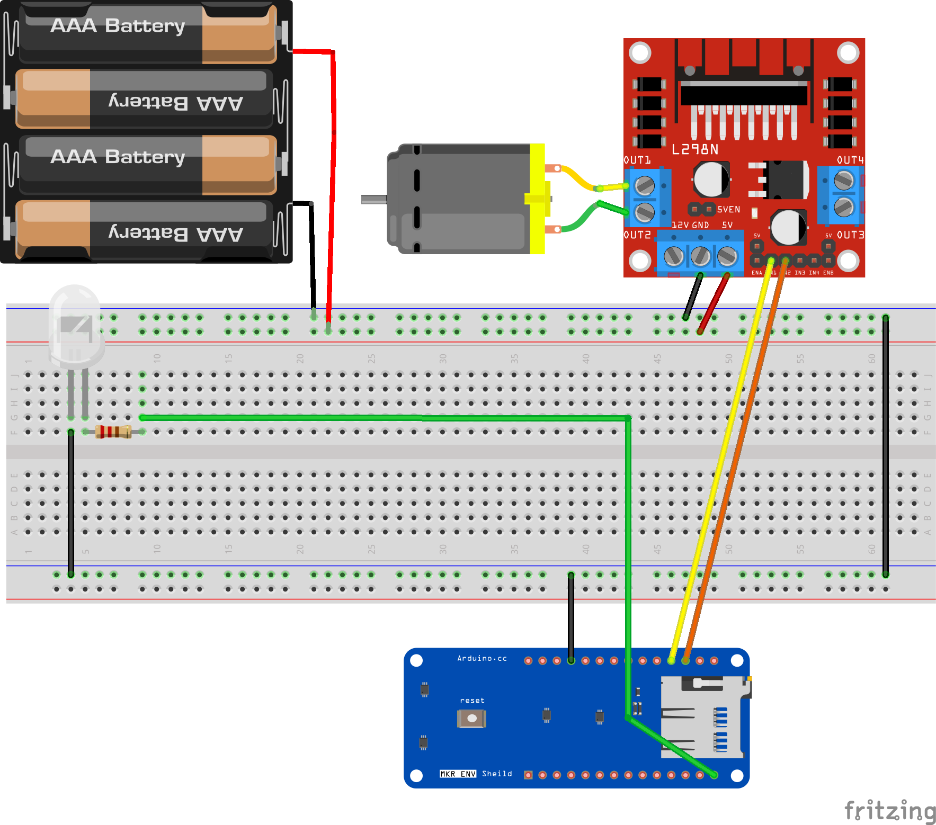
Stretch tasks
Develop your code so that the LED automatically turns on when the ambient light drops below a certain level
Add a motor with a fan blade to circulate the air within your biodome

Slide 10
Summary
The MKR ENV Shield allows you to take a wide range of environmental measurements
A breadboard can be used to built a range of electrical circuits
The Arduino IoT cloud can store readings from sensors and also allow remote control of output devices

